Slide 1
Understanding the Ecology of White-Tailed Deer Populations
Charlie Roth
DATA 205
CRN 33334

Slide 2
DATA
Parks:
Arkansas Post National Memorial
Pea Ridge National Military Park
Wilson’s Creek National Battlefield
Data collected by National Park Service and the U.S. Census Bureau.
Dataset sources: data.gov, census.gov
The Census data is population for counties surrounding the national parks.
Population estimates from American Community Survey (ACS) 5-year data.
Some variables include:
weather descriptions
number of deer
Year
Longitude & latitude
Counties:
Arkansas County, AR
Benton County, AR
Christian County and Greene County, MO
ACS 5-year data years:
2006-2010
2011-2015
2016-2020

Slide 3
Goal & Tools
My goal: Find what factors affect deer population specifically in the three national parks.
Deer populations affect a large number of things such as the ecosystem, agriculture, and people.
Tools I used:
RStudio libraries (tidyverse, viridis, paletteer, and GGally)
Tableau
Google Colab (Python pandas)

Slide 4
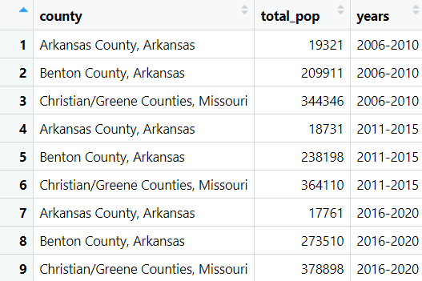
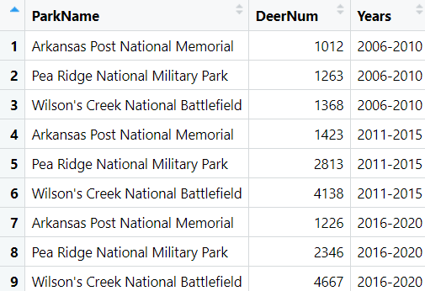
Summary of Data Cleaning
Renamed columns to make analysis easier.
Combined columns for Christian and Greene Counties.
Able to compare the counties to the parks.
Created another dataset to match with the updated Census dataset.
Organized the data by years (2006-2010, 2011-2015, and 2016-2020).
Summed the number of deer for each park.
?
!

Slide 5
Basic Descriptive Statistics
EDA columns:
DeerNum
BeginTempCelsius
BeginPrecip
VegType
Month
DeerNum - the # of deer spotted at a single event or sighting.
Ranges from 1 to 54 deer spotted in an event.
BeginTempCelsius - the beginning temperature in celsius for the event.
Temp. data has a normal distribution, unimodal and symmetrical.
BeginPrecip - the beginning precipitation at the event.
Describes precipitation:
“no rain”,
“light rain”
VegType - the vegetation type that the deer was spotted in.
Examples:
“Savanna”
“Upland scrub”
“Riparian forest”
Month - only has 3 months:
January
February
March

Slide 6
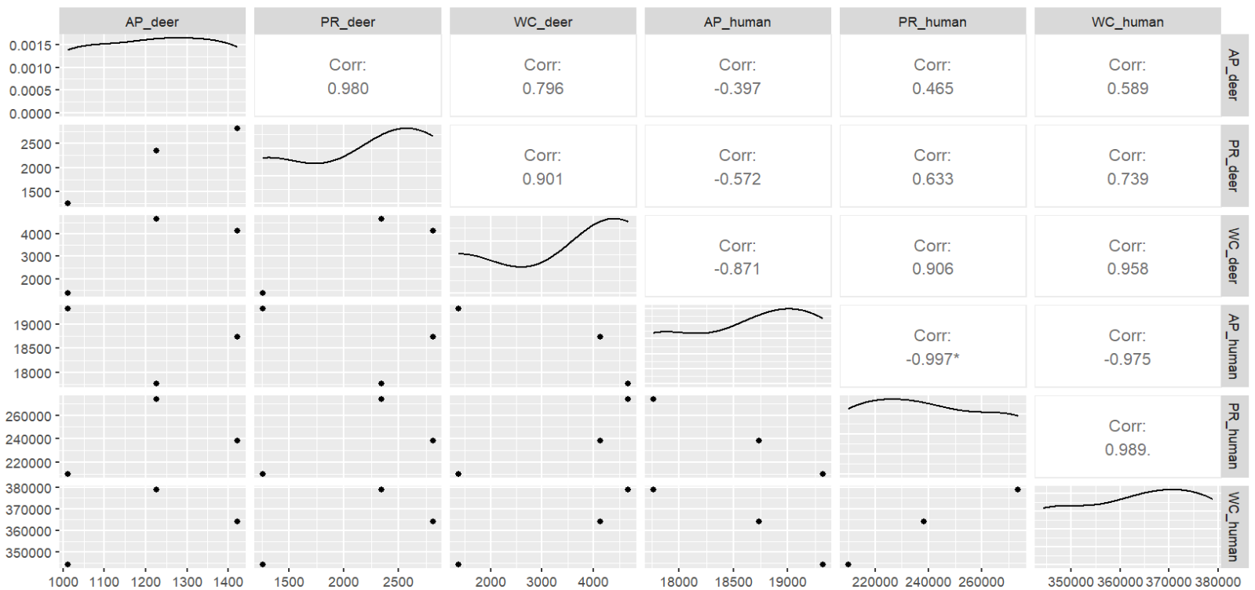
Description of Final Data Product
I analyzed the human population of the counties surrounding the three national parks.
I created a pairwise plot to see any correlations between the deer and human populations.
Out of the parks, Wilson's Creek populations are the only one with strong correlation.
Tell potential investors how you plan to leverage momentum after your launch.

Slide 7
Description of Final Data Product
The models for Arkansas Post and Pea Ridge both had negative R-squared and a high p-value. Wilson's Creek model on the other hand, had a high R-squared and a non-significant p-value. This is most likely due to a small sample size.
To look into the relationships of human and deer populations and see if there is a reason behind the difference in correlations, I decided to do linear regression models for each of the three parks.
Based on the results from the models, I believe that the sample size is too small to make any conclusions on if deer population size is affected by human population size.

Slide 8
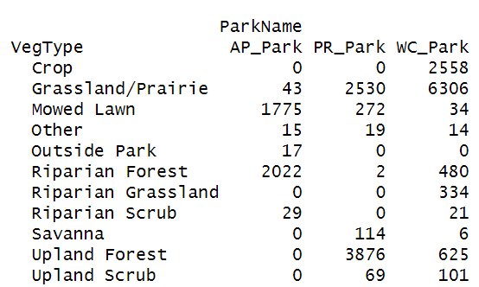
Description of Final Data Product
I created a contingency table for vegetation type in each park. The frequency is the number of deer sighted in that vegetation for each park.
Wilson's Creek the majority deer sighted are in grassland/prairie.
Pea Ridge, the majority of the deer were sighted in upland scrub or grassland/prairie.
Arkansas Post, the majority of deer were sighted in riparian forest.

Slide 9
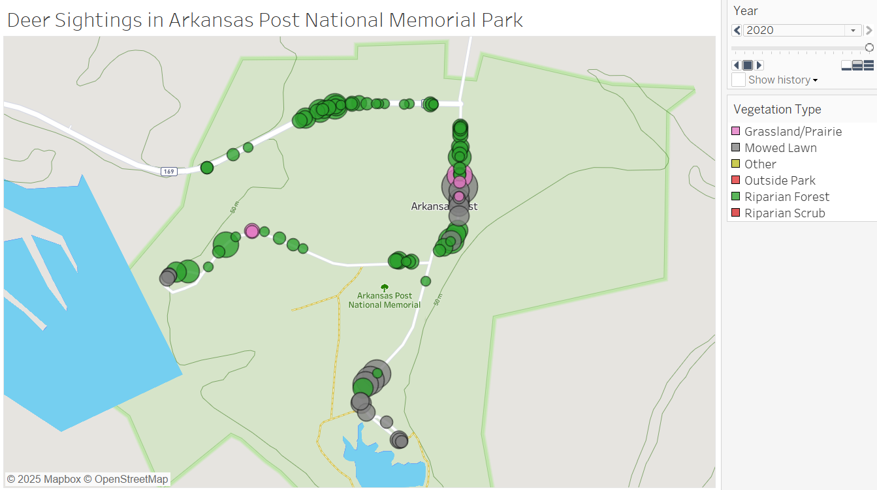
Description of Final Data Product
I visualized this with three interactive tableau plots for each park. You can see Arkansas Post’s plot below.

Slide 10
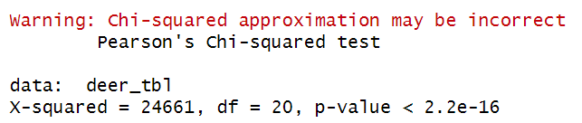
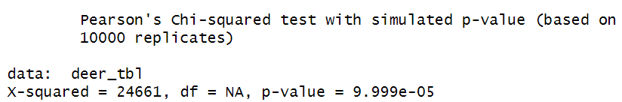
Description of Final Data Product
I used the contingency table to perform a Chi-squared test.
The Chi-squared test shows a very small significant p-value.
Shows a warning that the test approximation may be incorrect.
Some of the values in the contingency table are low or zero.
To fix this, I performed a Chi-squared test with simulated values.
From the second test, you can see that the p-value is higher but still below the significance level.
Based on these two tests, it's safe to say that there is a significant relationship between vegetation and number of deer.

Slide 11
References and Acknowledgements
The datasets used in this project came from data.gov and census.gov. The data was collected by the National Park Service Heartland Inventory and Monitoring Network and the U.S. Census Bureau. I would like to thank my data teachers over the semesters, Professor Saidi, Professor Alraee, and Professor Perine, who are the reason I was able to complete this project with the knowledge I learned in their classes.

Slide 12
Thank you!

